Slide 1
EXPLORATORY DATA ANALYSIS (EDA) ON MARKETING CAMPAIGN
By Peace Ugochi GINIKA

Slide 2
INTRODUCTION
OBJECTIVE:
This project is an EDA on a marketing campaign dataset.
Data Source:
200,005 rows and 15 columns of data covering key marketing campaign and performance metrics such as Campaign ID, Company, Campaign Type, Target Audience, Duration, Channel Used, Conversion Rate, Acquisition Cost, ROI, Location, Clicks & Impressions, Engagement Score, Customer Segment.
Extract key insights that will help understand and improve campaign effectiveness, audience engagement, and financial efficiency.

Slide 3

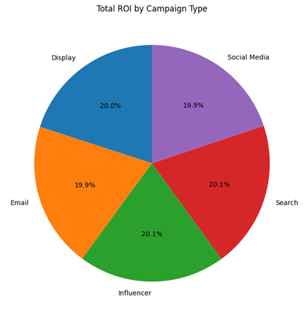

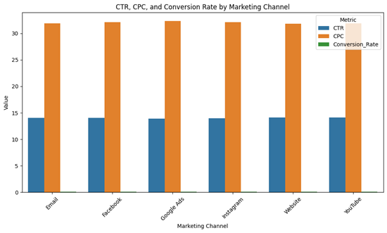
Findings & Insights - Data Visualizations
CAMPAIGN PERFORMANCE BASED ON ROI
Key Insights:
Balanced distribution, No extreme outliers: Each contributes roughly 20% of total ROI, suggesting no single channel dominates, indicating fairly even performance
Recommendations:
Analyze individual campaigns, within each channel, Investigate ROI in Relation to Cost to identify true efficiency, Test Channel Synergies, Combine channels
B. CAMPAIGN EFFECTIVENESS ACROSS DIFFERENT CHANNELS BASED ON CTR, CPC AND CR
Key Insights:
CTR is relatively consistent across all marketing channels, CPC is dominant value in the chart, CR is very small
Recommendations:
Identify high-cost, low-converting channels and improve ROI, Test different messaging and visuals for better audience engagement, Consider shifting budget to channels that drive more CPC

Slide 4
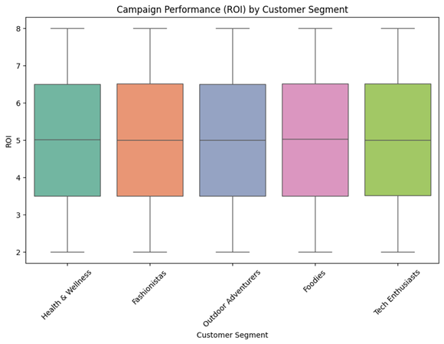
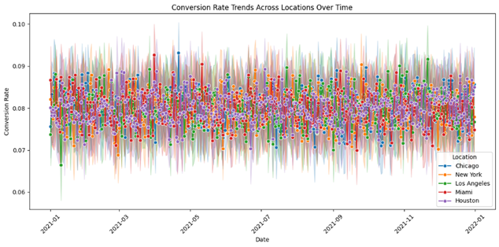
C. CAMPAIGN PERFORMANCE BASED ON CUSTOMER SEGMENT
Key Insights:
Health & Wellness, Fashionistas, and Foodies have slightly higher median ROIs (around 5) compared to Outdoor Adventurers and Tech Enthusiasts (around 4 to 4.5), suggesting that campaigns targeting the segments may be more consistently profitable. Tech Enthusiasts exhibits the lowest median ROI.
Recommendations:
Identify top ROI campaigns in each segment and analyze what contributed to their success; Apply those winning strategies more broadly. Conduct targeted experiments within each customer segment to find the best-performing creatives and offers.
D. COMPARING - CR TRENDS ACROSS LOCATIONS OVER TIME
Key Insights:
Conversion rates for all locations fluctuate within a narrow band (around 6%–10%), suggesting no single location dominates or underperforms drastically; All cities exhibit ups and downs throughout the year, indicating seasonal effects or campaign-specific influences;
Recommendations:
Since differences are subtle, a different approach such as comparison may reveal hidden performance drivers; Investigate what caused short-term surges or drops in conversion rate (e.g., new promotions, external events).

Slide 5
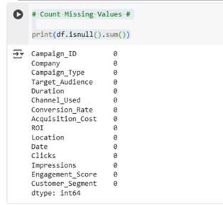
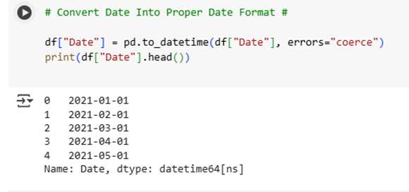
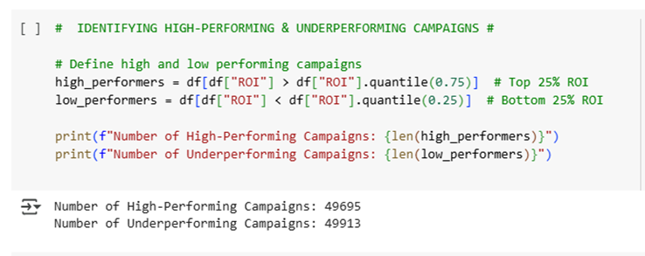
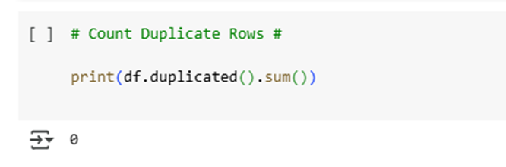
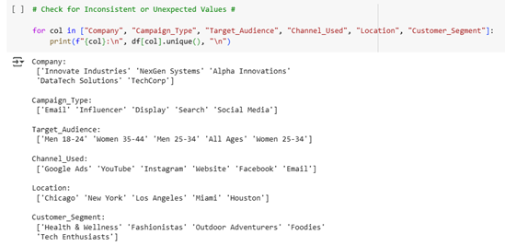
Code &
Methodology
Identifying Missing Values
Converting Dates to Proper Formats
Identifying The Highest and Lowest Performing Campaign Type
Checking for Duplicate Records
Checking for Inconsistencies
No missing values
No duplicates found
No Inconsistency

Slide 6
Conclusion
Recommended Further Analysis
Overall Campaign Performance: ROI varies from 2x to 8x, with some campaigns delivering high returns and others falling below expectations. Conversion rates remain relatively low, indicating that despite decent CTR, many campaigns struggle to convert.
Channel Effectiveness: CTR is fairly consistent across channels, though some spikes suggest campaign-specific success; Acquisition cost varies widely, implying different budget allocations and efficiencies across campaigns.
Engagement & Audience: Engagement scores range from 1 to 10, showing significant disparity in how users interact with different campaigns; Certain demographics (e.g., Men 25-34, Women 35-44) appear more responsive, but deeper segmentation may uncover hidden trends.
Outliers & Distribution: Box plots revealed outliers in clicks and ROI, indicating either exceptional successes or potential data anomalies; Wide distributions in cost and impressions suggest both very high-budget, high-reach campaigns and smaller, more targeted ones.
Demographic & Psychographic Insights: Explore how different age groups, interests, or customer segments influence engagement and conversions.
Channel-Audience Match: Identify which channels resonate best with specific segments to tailor future campaigns more precisely
User Journey Mapping: Understand at which point in the user journey potential customers drop off.
Resource Allocation: Evaluate whether shifting budget from underperforming to high-performing campaigns boosts overall ROI.
Campaign Timing: Determine if launching campaigns during specific weeks or months significantly affects CTR and conversions.
Channel Strategy: Experiment with different channel mixes to see how channel synergy affects overall performance.

